Slide 1
…
Tim Volonakis

Slide 2
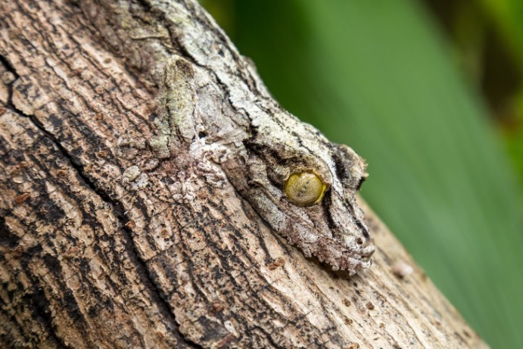
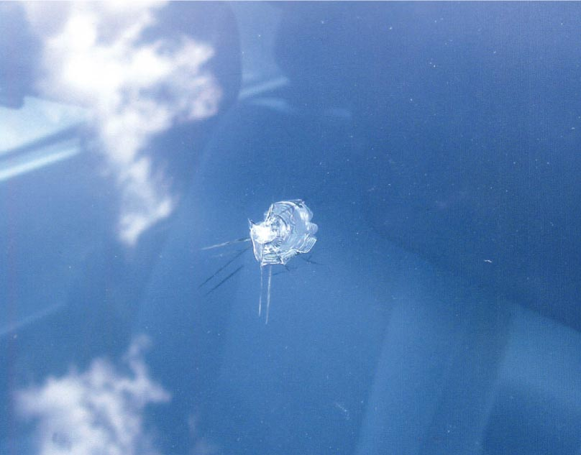
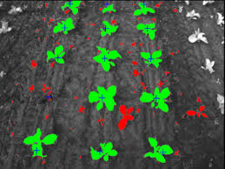
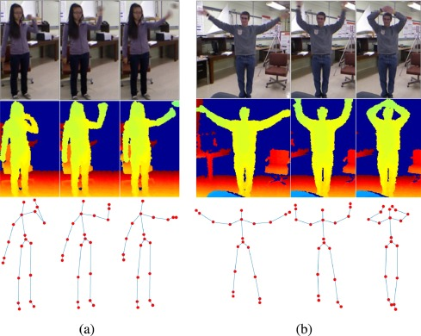







Introduction
Camouflage
Autoglass
Weed Detection
Action Recognition

Slide 3
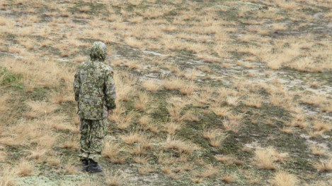


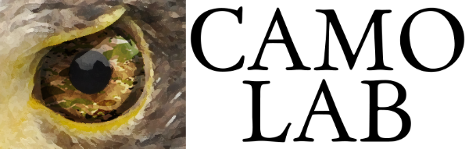
Camouflage Assessment

Slide 4
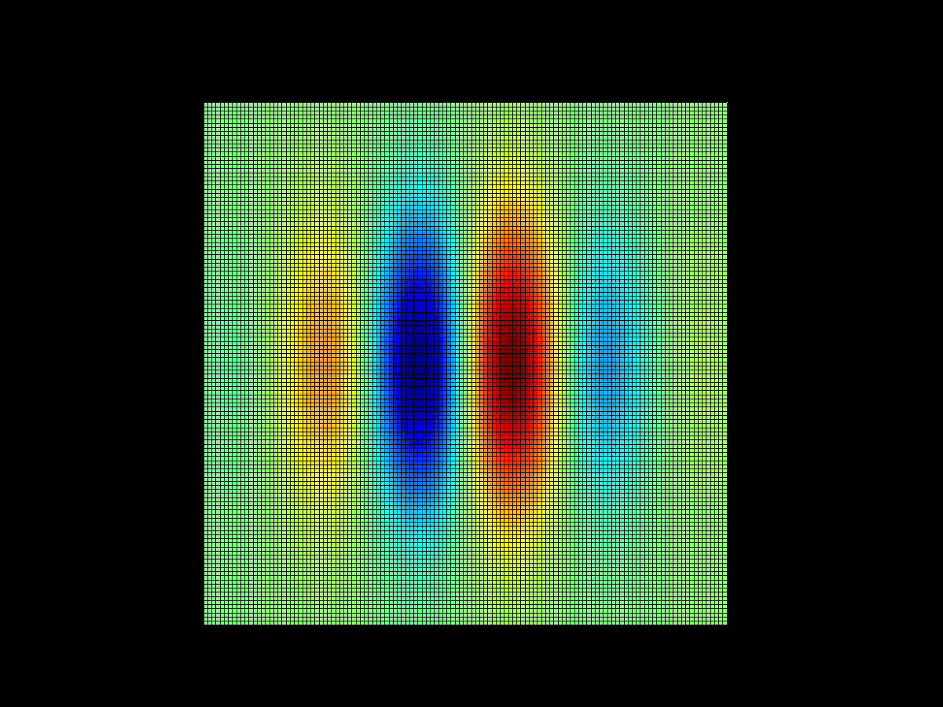
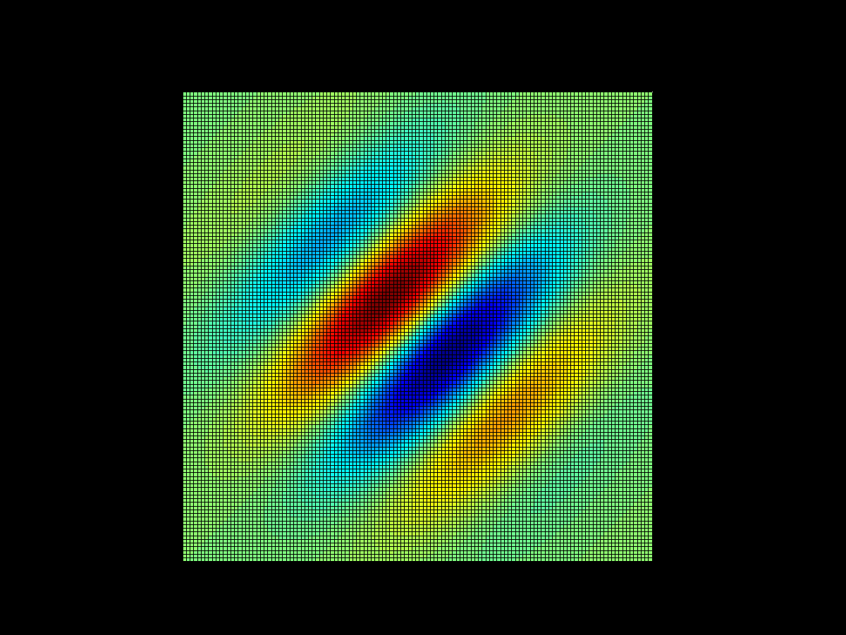
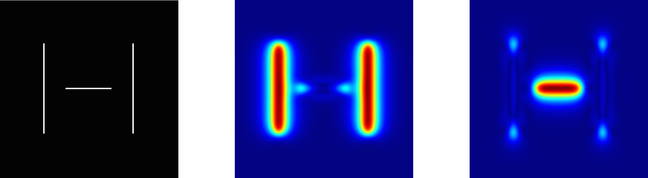
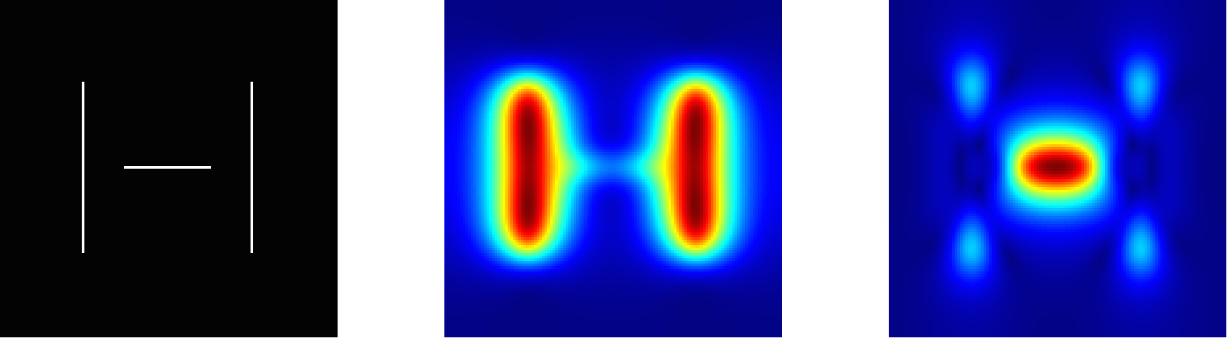
The Observer Model
1. Filter with log Gabors
2. Compute Local Energy and Phase
3. Sample
4. Model using mixture Of Gaussians
Volonakis, T. N., Matthews, O. E., Liggins, E., Baddeley, R. J., Scott-Samuel, N. E., & Cuthill, I. C. (2018). Camouflage assessment: Machine and human. Computers in Industry, 99, 173-182.

Slide 5
Modelling Colour
Colour in the periphery
What colour features
How to combine texture and colour features

Slide 6

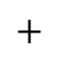







MacLeod & Boynton Colour Space
S
M
L
M
L
M
L
$+$
$−$
$−$
$−$
$+$
$+$
$+$
$$+$$
S vs. LM
L vs. M
L $+$ M

Slide 7
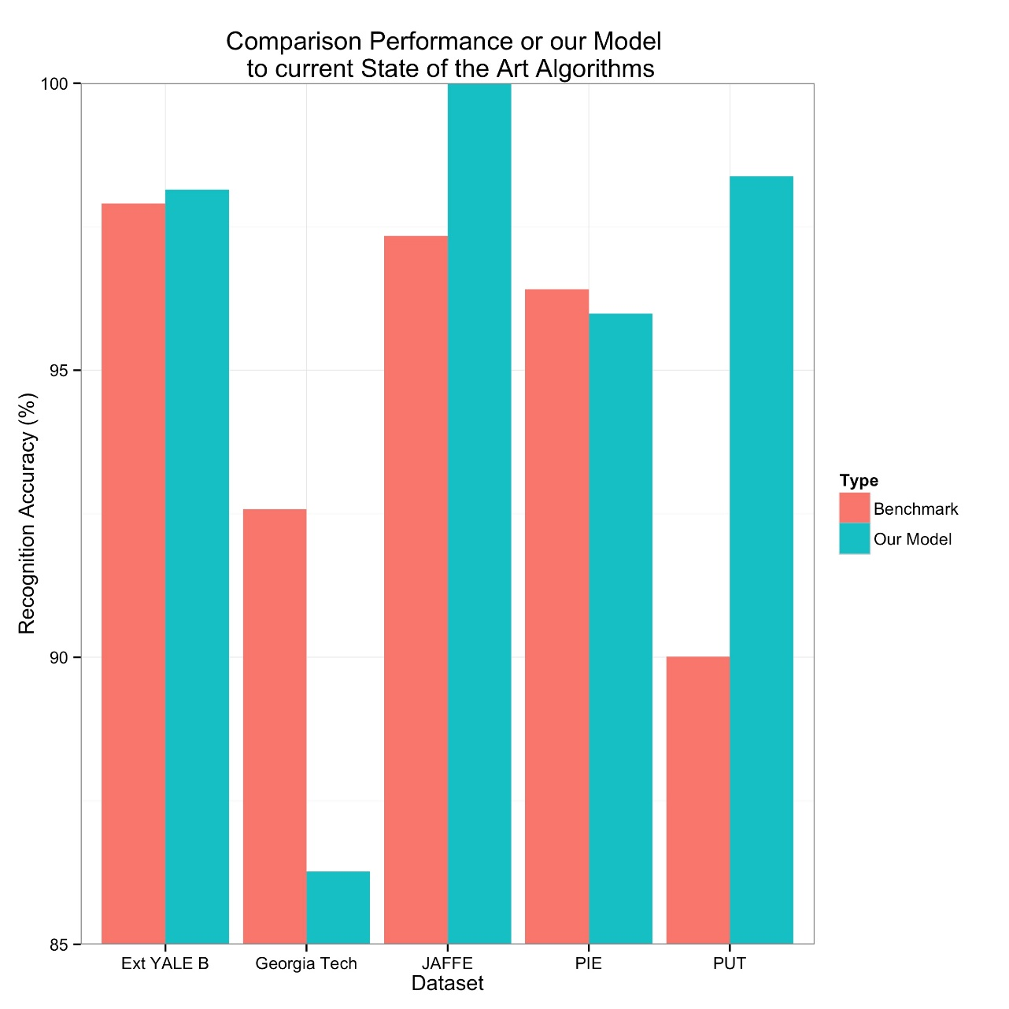
Accuracy at Face Recognition
Accuracy Comparison with State of the Art (at the Time)

Slide 8
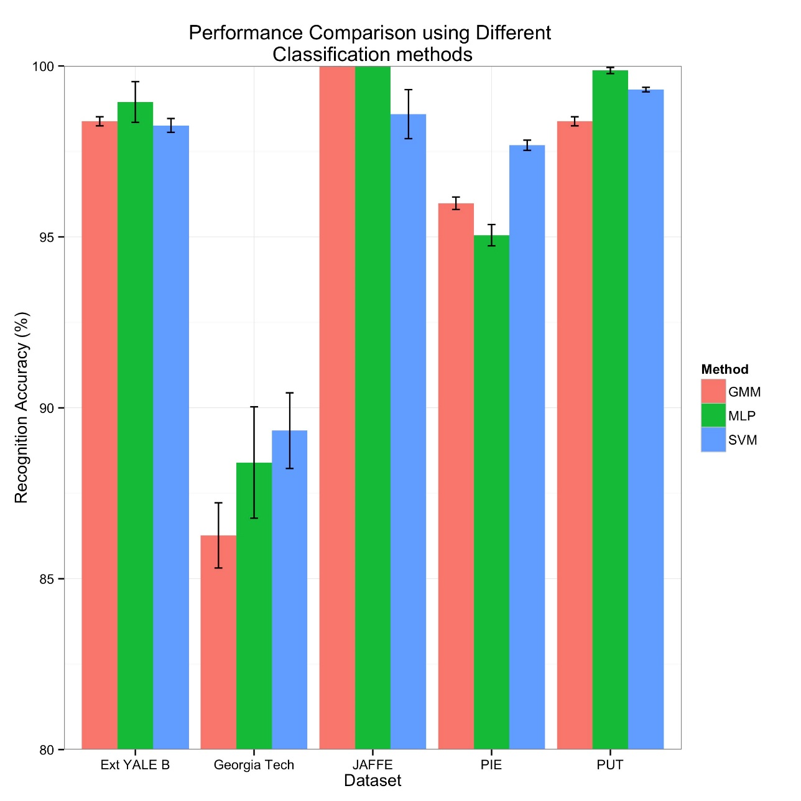
GMM vs. MLP vs. SVM
Accuracy Comparison with Different Machine Learning Architecture

Slide 9
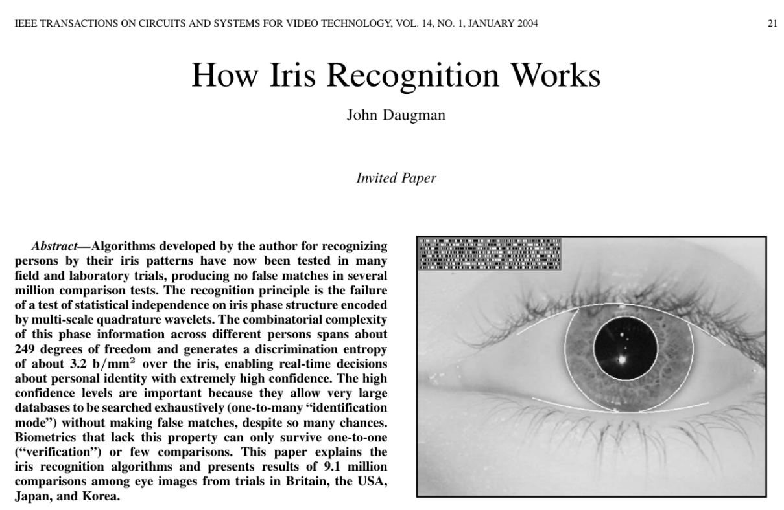
Local Energy and Phase is powerful at representing objects
Features Are Good

Slide 10
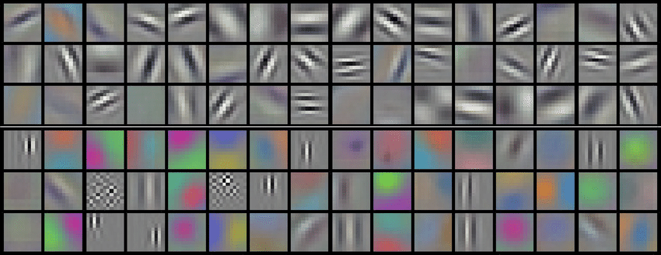
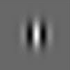
Features are Present in 2D Conv Nets
Krizhevsky’s Features from ImageNet
2D Gabor

Slide 11
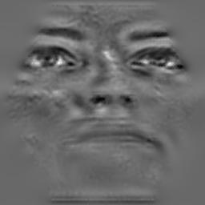
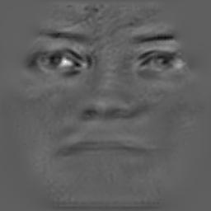
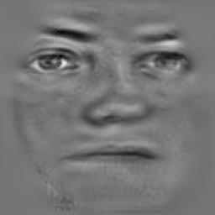
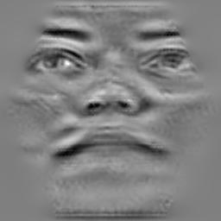
Variations in Head Pose

Slide 12
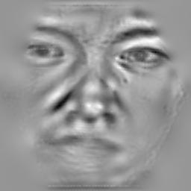
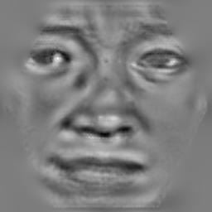
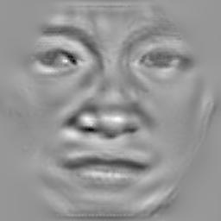
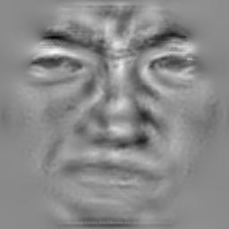
Variation in Facial Expressions

Slide 13
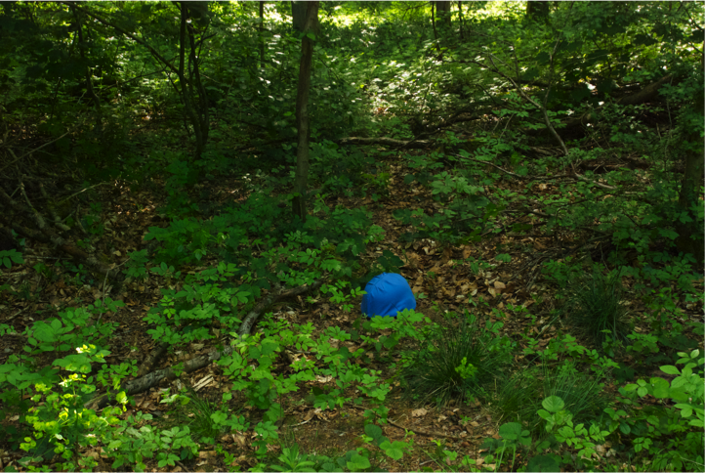
Camouflaged Objects in Woodland

Slide 14
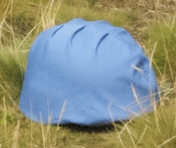
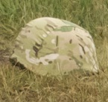
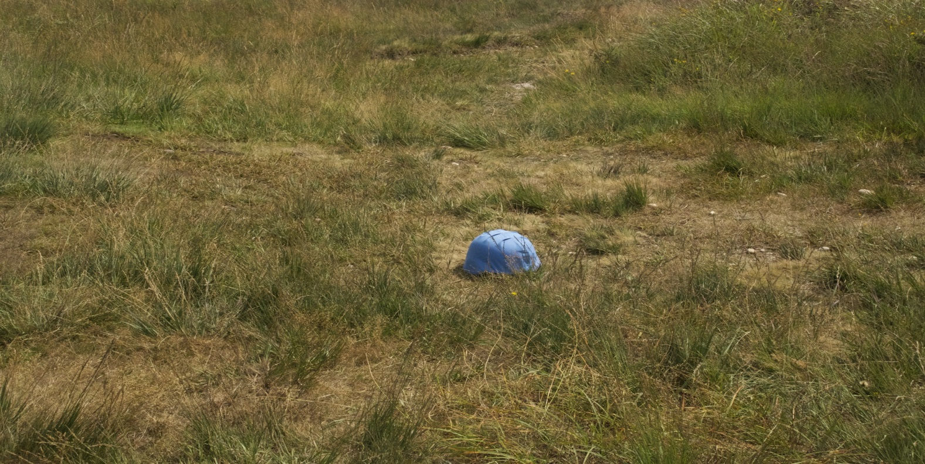
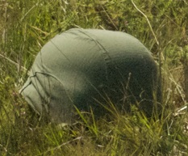
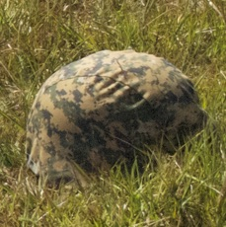
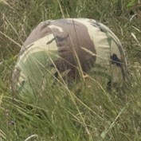
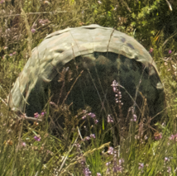
Camouflaged Objects in Scrubland

Slide 15
Comparing Accuracy
Both observers’ behaviour needs to be compared
We need to task them with the SAME task

Slide 16
The Human Experiment (1/4)

Slide 17
The Human Experiment (2/4)

Slide 18
The Human Experiment (3/4)

Slide 19
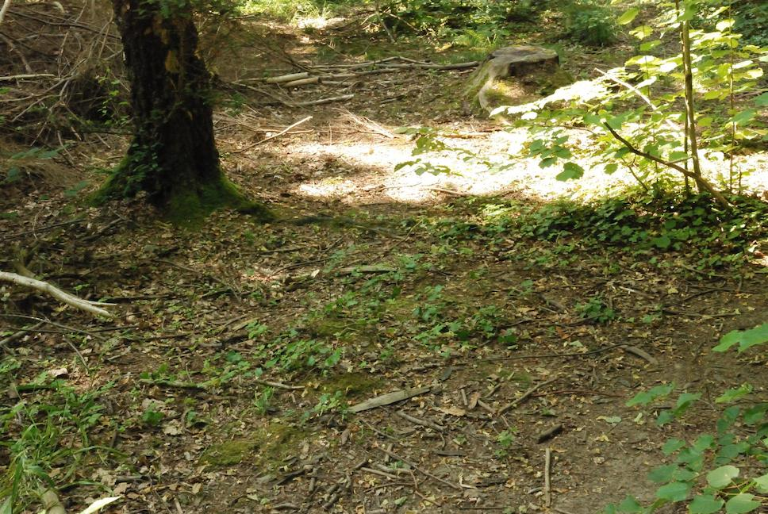
The Human Experiment (4/4)

Slide 20
Bayesian Recognition
A
Show a pair of unseen images to the model
One helmet, one background
Evaluate maximum posterior probability which is a helmet
B

Slide 21
Bayesian Recognition
Helmet
Background
Models
P(A|Background)
P(A|Helmet)
P(B|Background)
P(B|Helmet)
A
B
Images

Slide 22
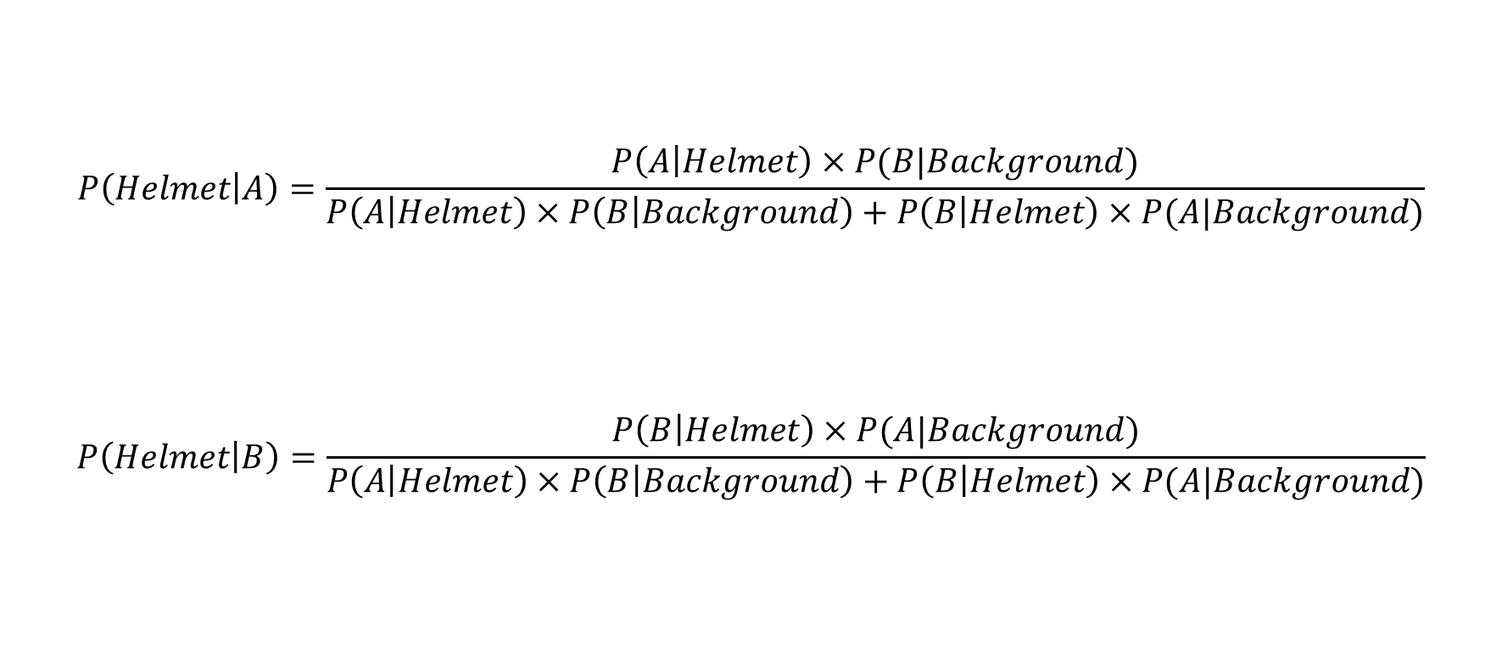
Bayesian Recognition
$$P\left(Helmet | A\right)=\frac{P\left(A | Helmet\right)×P(B|Background)}{P\left(A | Helmet\right)×P\left(B | Background\right)+P\left(B | Helmet\right)×P(A|Background)}$$
$$P\left(Helmet | B\right)=\frac{P\left(B | Helmet\right)×P(A|Background)}{P\left(A | Helmet\right)×P\left(B | Background\right)+P\left(B | Helmet\right)×P(A|Background)}$$

Slide 23
Bayesian Detection
A
Scene
B

Slide 24
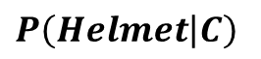

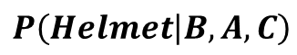

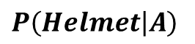


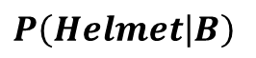
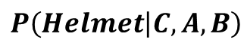
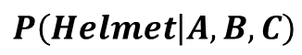

Bayesian Detection
A
$$P\left(Helmet | A\right)$$
$$×$$
$$P\left(Helmet | A,B,C\right)$$
$$+$$
$$P\left(Helmet | B\right)$$
$$×$$
$$P\left(Helmet | B,A,C\right)$$
B
$$+$$
C
$$P\left(Helmet | C\right)$$
$$×$$
$$P\left(Helmet | C,A,B\right)$$

Slide 25

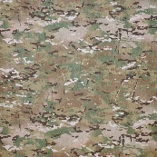
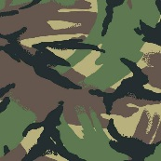
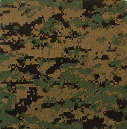
Greyscale Recognition: Woodland
Model Accuracy (%)
Human Accuracy (%)

Slide 26
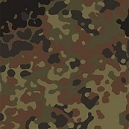
Greyscale Recognition: Scrubland
Model Accuracy (%)
Human Accuracy (%)

Slide 27
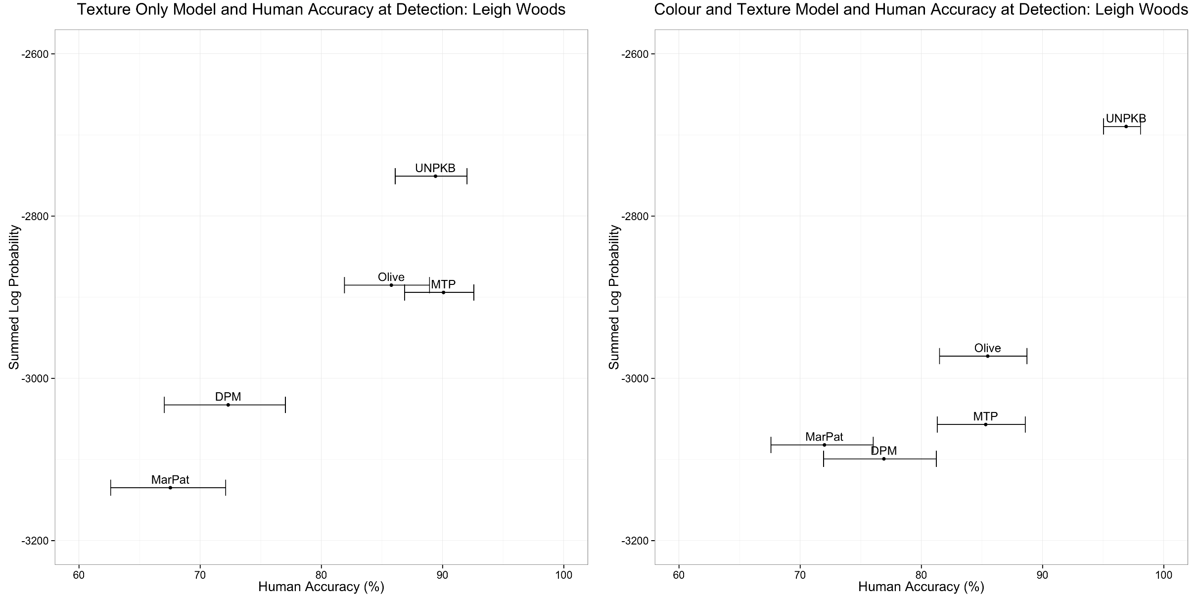
Helmet Detection: Woodland
Accuracy at Detection (Texture): Woodland
Accuracy at Detection (Colour Texture): Woodland

Slide 28
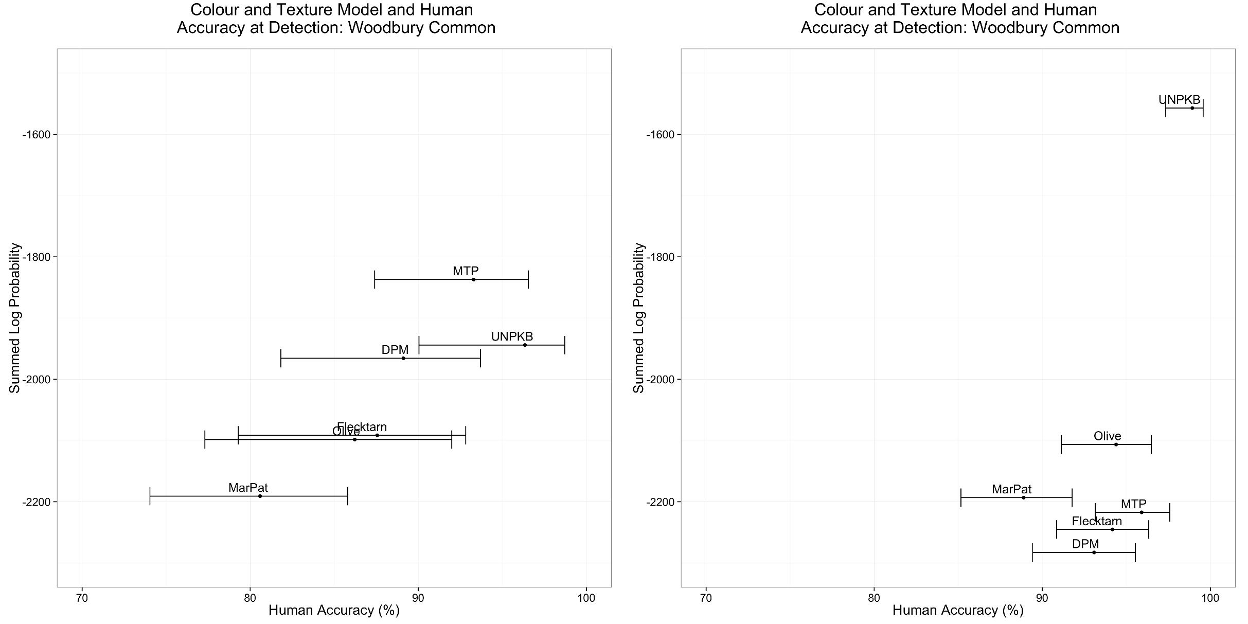
Helmet Detection: Scrubland
Accuracy at Detection (Texture): Scrubland
Accuracy at Detection (Colour & Texture): Scrubland

Slide 29
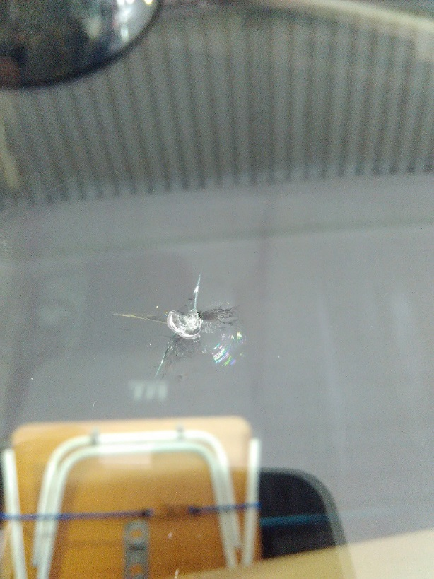
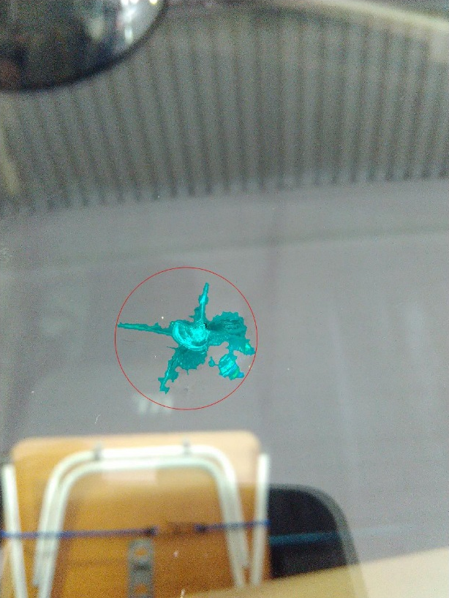


Windscreen Cracks

Slide 30
Windscreen Cracks – One Approach
Find the centre of impact
Log Polar Transform immediate area
Evaluate ‘spider legs’
If lots of vertical information – likely to be a crack

Slide 31
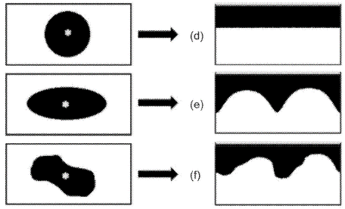
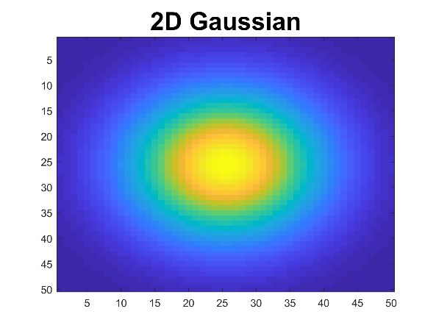

One Approach - Polar Transform
Cartesian Domain
Polar Domain
Circle
Ellipse
Irregular Polygon
Gaussian

Slide 32




Saliency
Original Stimulus
Original Stimulus
Saliency Map

Slide 33

Saliency Benchmark
Deep Learning Dominating!!

Slide 34


Boolean Map Saliency
Original Image
BMS Saliency

Slide 35

Detecting the Centre of Impact
Original Image
BMS Saliency

Slide 36



Detecting the Centre of Impact

Slide 37

Log Polar Transform Features
1. Image
2. Edges
(Canny)
3. Log Polar Transform
4. Vertical Information Retained

Slide 38



Segmentation Algorithm
1. Original Image
2. Butterworth Band passed
3. Threshold

Slide 39


Windscreen are Dirty

Slide 40
What Dust Looks Like

Slide 41

Dust Detection
Compute the horizontal and vertical gradients
Convolve with DoG
Sum vertical and horizontal output

Slide 42
Dust Detection: Image Pipeline
Image Input
(Dust)
Horizontal Gradient
Convolved with DoG

Slide 43
Dust Detection: Image Pipeline
Original Dust Input
Final Dust Representation

Slide 44

Dust Particle Detection
Original Image
Detected Dust in Red

Slide 45

Dust Particle Detection
Original Image
Detected Dust in Red

Slide 46










Neural Network Dust Classifier
DUST
NOT-DUST
2 Nodes for Classification
400 (${20}^{2}$) Input for
Dust and Not-Dust Images
100 Hidden Nodes

Slide 47

Real World Rectification
Show triangulation with phone

Slide 48

Ground Truth vs Estimate Size
Correlation: 0.58
Strong Correlation

Slide 49

Automotive Body Damage Analysis

Slide 50


Challenging Problem
Image of a Dent
3D Project Key points

Slide 51



Plaster of Paris Mould

Slide 52


Fringe Pattern Projection

Slide 53


Polarisation
Without Polarisation
Using Polarisation Filters

Slide 54


3D Reconstruction of Dent
RAW Fringe 3D Reconstruction
Interpolated Fringe Reconstruction

Slide 55



Compare with Ground Truth
Iterative Closest Point Matching
Ground Truth
Fringe Reconstruction

Slide 56

3D Reconstruction Accuracy
3D Measurement Error (mm)

Slide 57


Fringe Reconstruction of Face
3D Printed Face
3D Reconstruction

Slide 58

Weed Detection

Slide 59


Example Images of Dock Weed
Image
Dock Leaves Labelled
RED: Dock leaves

Slide 60


Labelling Dock is Non-trivial
Image
Dock Leaves Labelled
RED: Dock leaves

Slide 61
Detection for Spray Boom
1 metre
1 metre

Slide 62


Recognition Approaches
Local Binary Patterns
&
Support Vector Machine
Convolutional Neural Network
Pre-trained on ImageNet

Slide 63


Local Binary Patterns
3
4
8
0
0
1
2
4
6
0
1
2
1
5
0
0
1
3$×$3 Pixel Window
Pixel Intensities
Local Binary Pattern
Binary Pattern: 1100001
= 1 + 64 + 128
= 193

Slide 64
Results at Weed Recognition
Local Binary Patterns + SVM
Convolutional Neural Network
 | Grass | Dock
Grass | 0.80 | 0.20
Dock | 0.06 | 0.94
 | Grass | Dock
Grass | 0.93 | 0.07
Dock | 0.01 | 0.99
Average Accuracy: 87.0%
Average Accuracy: 96.0%
Zhang, W., Hansen, M. F., Volonakis, T. N., Smith, M., Smith, L., Wilson, J., ... & Wright, G. (2018). Broad-leaf weed detection in pasture. IEEE 3rd International Conference on Image, Vision and Computing (ICIVC) (pp. 101-105).

Slide 65
Action Detection in the Home

Slide 66


Panasonic’s 8$×$8 Infrared Sensor

Slide 67
Actions
Falling
Sitting Still
Sit to Stand
Stand to sit
Walking left to right
Stand Still
Walking right to left

Slide 68


2D DCT

Slide 69


2D DCT of the letter ‘A’

Slide 70

2D DCT
Tao, L., Volonakis, T., Tan, B., Jing, Y., Chetty, K., & Smith, M. (2018). Home Activity Monitoring using Low Resolution Infrared Sensor. arXiv preprint arXiv:1811.05416.

Slide 71

Example Fall Sequence
An Example Fall Sequence

Slide 72

3D Convolutional Neural Network

Slide 73

Detecting Actions in Rooms
Tao, L., Volonakis, T., Tan, B., Jing, Y., Chetty, K., & Smith, M. (2018). Home Activity Monitoring using Low Resolution Infrared Sensor. arXiv preprint arXiv:1811.05416.
Tao, L., Volonakis, T., Tan. B., Zhang Z., Jing, Y. & Smith, M. (2018). 3D Convolutional Neural network for Home Monitoring using Low Resolution Thermal-sensor Array, 3rd IET International Conference on Technologies for Active and Assisted Living (TechAAL2019) (Submitted).

Slide 74
Summary

